Slide 1


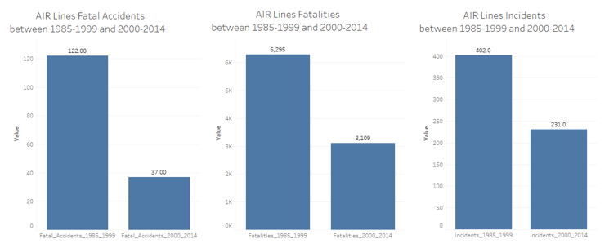
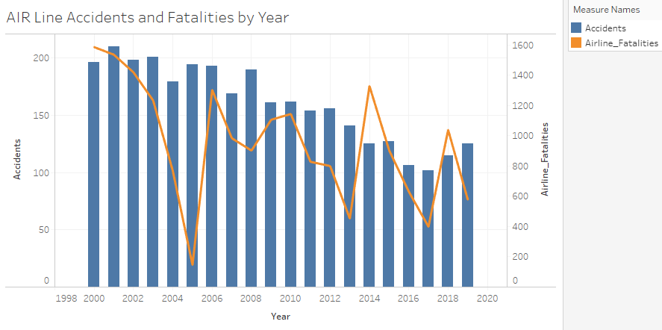
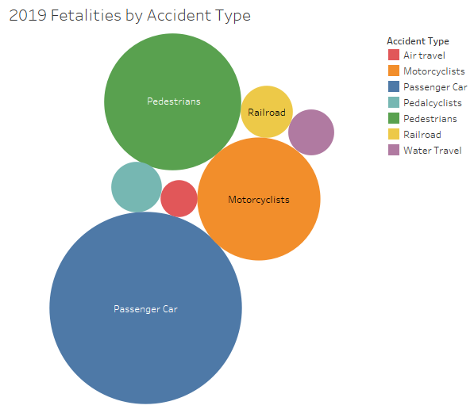
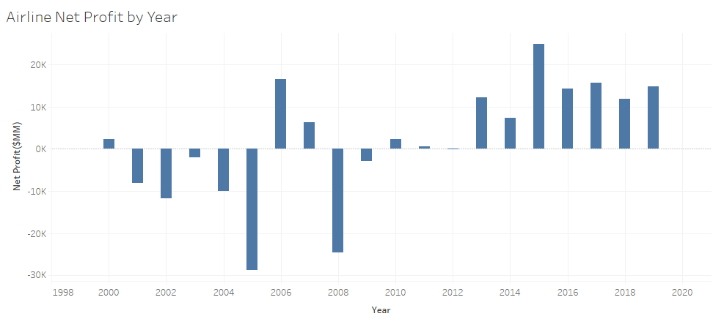
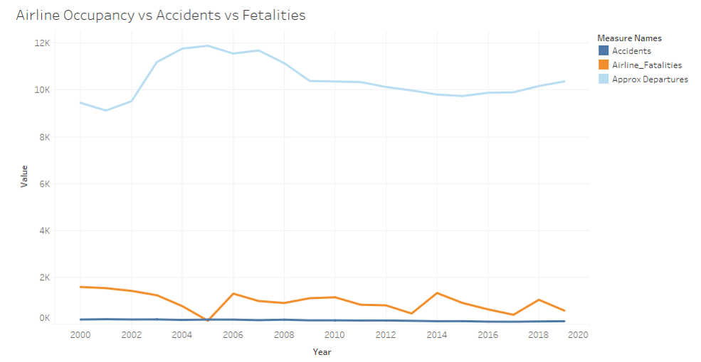
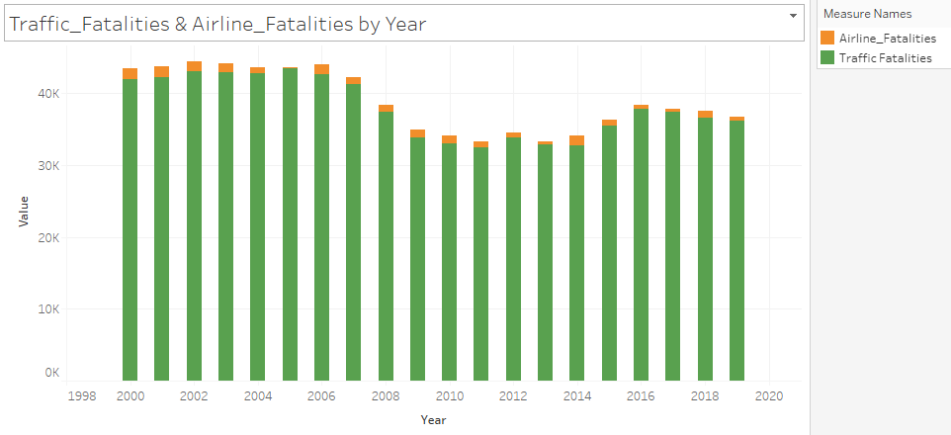

Is AIR TRAVEL Safe..??
I am flying to LA for summer holidays..!!
What are your plans..?
Air travel has become more reliable with many safety measures implemented in the recent years.
Fatal Accidents and number of Fatalities has reduced in half compared to last decade.
While the Airline flight departures has remained fairly consistent, the number of accidents has reduced significantly.
Airline incidents are very low compared to all other type of incidents with in an year.
Increase in profit over years proves the people trust in the air travel which is only going to increases in future.
Taking kids to Disney, worried about air travel
Safety, going on a road trip.
Many safety measures are implemented by air lines, its more reliable than
road journey.
Reference:
Airline Safety: https://github.com/fivethirtyeight/data/tree/master/airline-safety
Traffic Fatalities: https://en.wikipedia.org/wiki/Motor_vehicle_fatality_rate_in_U.S._by_year
Net Profit: https://www.airlines.org/dataset/annual-results-u-s-passenger-airlines/#
Airline Accidents: List of accidents and incidents involving commercial aircraft – Wikipedia
Transportation: Transportation Fatalities by Mode | Bureau of Transportation Statistics (bts.gov)

